Slide 1

Meeting minutes 2-20-2015
HOMEOWNERS ASSOCIATION BOARD MEETING
FEBRUARY 20th, 2025
Meeting called to order at 7:05 pm
By President , Lorraine Rodriguez
Rolls call, all present
Member reports Lorraine announced the Oath of new Board. Treasure Report. Minutes from last membership meeting. Old Business, water meters, Rent increase
New Board announce Oath given by Karen Gitlin New Board took over the meeting.
President. Al Wolden announced Steve Gitlin Vice President, Rich Miller Treasure, Deborah Corona Secretary, Civic Affairs, Social Director
New business: Asked for Tech advisors and other positions for all Took questions from members.
Motion to adjourn 7:52 pm. 1st WT, 2nd Noreen

Slide 2
Treasurer's Report
CD #1 - $11,610.16
CD #2 $8,675.28
Checking $2,434.81
Members Dues - $30.00
Total = $22,750.25

Slide 3
Technical Committee Update
Web page is under construction
By Law document will be emailed and available after new By Law approval

Slide 4
Social Committee Update
New mobility scooter loaned to person of need
Upcoming events
Laua
Ladies Club Cake action

Slide 5
Social Committee Update
New mobility scooter loaned to person of need
Upcoming events
Laua
Ladies Club Cake action

Slide 6
By Law Committee
Review and discuss By Law changes
Vote on New By Laws

Slide 7
Flooding
Yes is getting quotes to clean the canal
Promised to have it cleaned by Hurricane season
Mitigate standing water by installing gravel drains ( East end of Sandhill)

Slide 8
Dogs
All biting and aggressive incident must be reported to authorities , Then the office. Pick up after your dog
Yes will purchase Pooh bag stands ,
We need 10 at least - $15.99 each on Amazon- They band to a structure or a standpipe.

Slide 9
Water Bills
Average is $40
Usage ~2,500-3,000
Base fee is $2:58
Water ~$20
Sewar~$20
Admin fee-$5
Tax ~$2:00

Slide 10
Speed Humps
Yes will install them

Slide 11
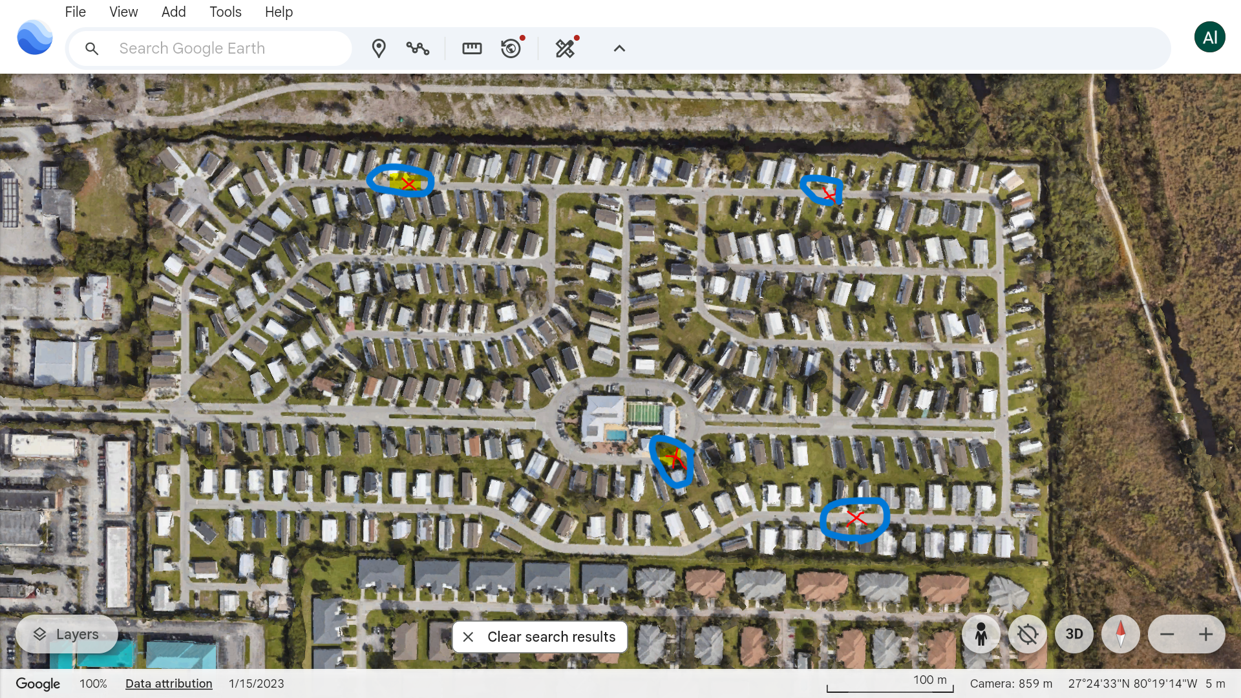
Speed Bumps

